Slide 1

LET‘S CREATE
COHESION POLICY POST 2027 TOGETHER
Aleš Mrkela, Head of Managing Authority
Vesna Engelman, Managing Authority programme manager
Informative workshop, Ptuj, 5 December 2024
www.menti.com use code: 6251 6884

Slide 2

WHERE WILL THE CITIES AND
REGIONS BE IN 2075 - AI
  Bureaucratic inefficiencies
  Digital divide
  Corruption and mismanagement
  Resource constraints
  Resistance to change
  Fragmented policies

Slide 3

WHERE WILL THE CITIES AND
REGIONS BE IN 2075 - PEOPLE
  Advanced digital governance
  Decentralised decision making
  Capacity building initiatives
  Integrated urban planning
  Efficient use of EU funds
  Enhanced public services
  New social models

Slide 4




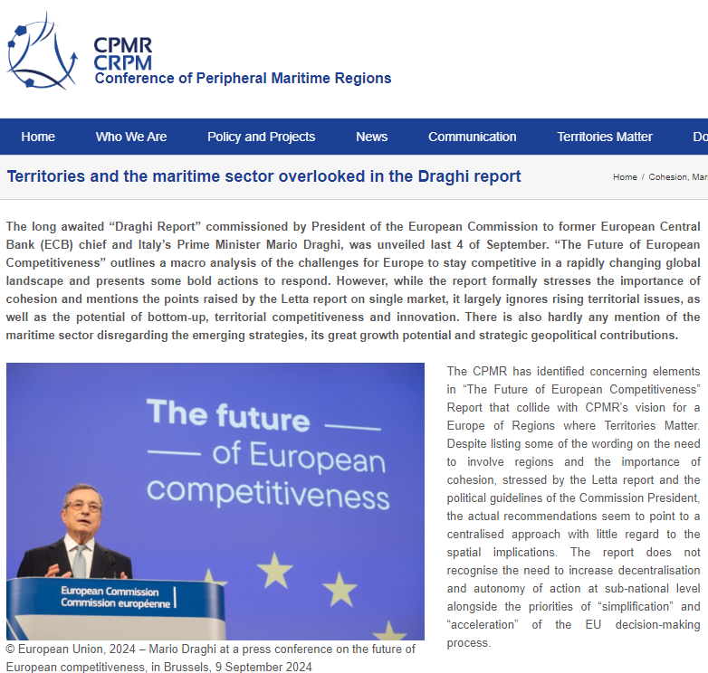
REQUIRED READING
9th Cohesion Report
Draghi‘s report
Letta report
HLGS - The future of Cohesion Policy
President‘s guidelines
EU competitiveness: Looking ahead - European Commission
https://institutdelors.eu/wp-content/uploads/2024/04/Much-more-than-a-market.pdf
Inforegio - The future of Cohesion Policy
Towards a new Commission (2024-2029) - European Commission
https://ec.europa.eu/regional_policy/information-sources/cohesion-report_en

Slide 5
LET‘S MENTI
www.menti.com use code: 6251 6884

Slide 6
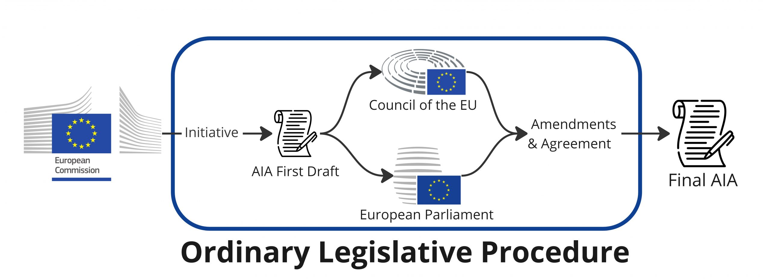
UNDERSTANDING OF
THE LEGISLATIVE PROCESS
It is about TRIOLOGUE between
European Commission, European Council and European Parliament
„Nothing is agreed until everything is agreed“

Slide 7
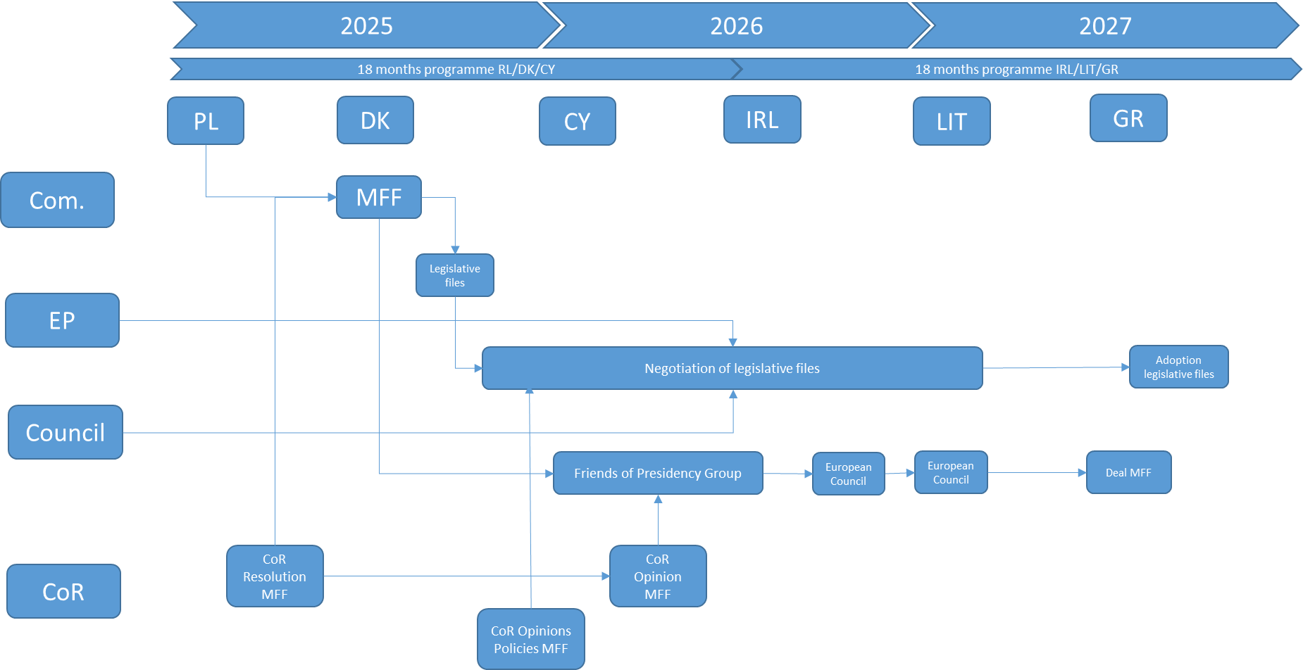
ESTIMATED TIMELINE

Slide 8
ABSORBTION SPEED

Slide 9

EMERGING PRIORITIES
  Security
  Defence
  Migration
  Green transition
  Digital transition
  Education and capacity of people
  Housing
  Demography
https://www.consilium.europa.eu/media/yxrc05pz/sn02167en24_web.pdf

Slide 10
POSSIBLE FUTURE OF CP
Around 530 programmes for Member States
(2021-2027 MFF)
Cohesion policy: 398 (national and regional programmes + 27 partnership agreements
Agriculture and fisheries: 54
Home funds: 79
Fisheries
Cohesion Fund
European Social Fund
Common
Agricultural
Policy
Funds
European Regional and Development Fund
Others: (e.g. Social Climate Fund)
Home Affairs funds
27 programmes for all Member States
Next MFF: “Single Plan” for each Member State
EC calls it
„European competitiveness fund“ – one per country
Single all-policy document for each
Simpler legal framework
Streamlined negotiations (more leverage and flexibility)
Less red tape

Slide 11
POSSIBLE FUTURE OF CP
European Competitiveness Fund
Strong policy agenda and strategic steer
Simplification and flexibility
Single rulebook (eligibility rules, third country participation, etc.)
Single governance
Possible reallocation of budget within the Single Fund
Reference framework identifying challenges and priorities for innovation and strategic dependencies
Steer by policies not by programmes
Focus on EU added value
Financial toolbox to adjust type of support and level of investment from the EU budget

Slide 12
POSSIBLE FUTURE OF CP
Strong policy agenda on joint EU priorities
European Semester CSRs
National and/or
Regional chapters
Investments (examples)
Reforms
(examples)
National Energy and Climate Plans
e.g. transport
Construction of rail line
Simpler public procurement
e.g. social
Social Housing
Addressing gender gap in employment
Reference Framework identifying challenges for the Member Stats (Pillar 1) and the EU (Pillar 2)
European Governance Plans
Faster permitting
e.g. energy
Renewable Energy
Promoting organic farming
Other policy tools (.e.g Schengen, Rule of Law
e.g. agriculture
Direct Payments
e.g. security and migration
Reception Facilities for migrants
Strengthening cross-border cooperation
Performance-based delivery model
Strong Conditionalities
Payments against fulfilment of policy objectives
Protection of EU financial interests , Rule of Law and EU values

Slide 13
CHALLENGES FOR FUTURE OF CP
Direct or Shared Management in the Implementation of Cohesion Policy Compared to the Reform Policy of the RRF
It is expected that more flexibility will be needed in reallocating funds between funds and in implementing smaller operations. Mechanisms will remain and exist to adjust funding and priorities based on emerging challenges and socio-economic conditions.
Continued Focus on Key Goals: The policy is likely to remain focused on goals such as economic growth, job creation, and sustainable development.
Simplification and Efficiency: Efforts to simplify rules and reduce administrative burdens will continue, making it easier for regions to access and use funds.
Enhanced Local Involvement and Territorial Approaches: It is necessary to ensure the administrative competence of local, urban, and territorial authorities in managing funds.

Slide 14
LET‘S MENTI
www.menti.com use code: 6251 6884

Slide 15
EU CHALLENGES
  Competition from the rest of the world is growing amid an increasingly fragmented geopolitical context.
  The ‘convergence machine’ has strongly decelerated after the global financial crisis. Going forward, need to foster (external) competitiveness and (internal) cohesion at the same time.
  Innovation – intended in a broad sense - as a key driver of long-run productivity growth, which has slowed down over the past fifty years in all advanced economies. Eastern Europe positive success story. Similar potential from further enlargements.
  While concentration of innovation can result in positive externalities, it may also widen spatial disparities. The demographic outlook in Europe also not particularly good.
  Competitiveness key to harness the potential of the green and digital transitions: what spatial implications? What role for place-based policies and approaches? How can they act in synergy with other policies? Who should finance them, and how?
  Cohesion policy key enabler of a partnership approach to productivity-enhancing strategies that takes into account local characteristics and is tailored to the level of development (education, institutions, R&D). How to improve its delivery on the ground?

Slide 16
GEOGRAPHY OF PRODUCTIVITY
The productivity of a nation is influenced by several key determinants:
Human Capital: The skills, education, and health of the workforce. A well-educated and healthy population can significantly boost productivity.
Physical Capital: The infrastructure, machinery, and technology available to workers. Better tools and infrastructure can enhance efficiency and output.
Innovation and Technology: Advances in technology and innovation can lead to new methods of production, improving efficiency and creating new products and services.
Institutional Framework: The quality of institutions, including the legal system, government policies, and regulatory environment, can impact economic activities and productivity.
Natural Resources: The availability and management of natural resources can affect productivity, especially in resource-dependent economies.
Economic Policies: Policies related to trade, taxation, and investment can influence productivity by shaping the economic environment.
Market Size and Competition: Larger markets and competitive environments can drive firms to be more efficient and innovative.
Cultural Factors: Cultural attitudes towards work, entrepreneurship, and innovation can also play a role in determining productivity.

Slide 17
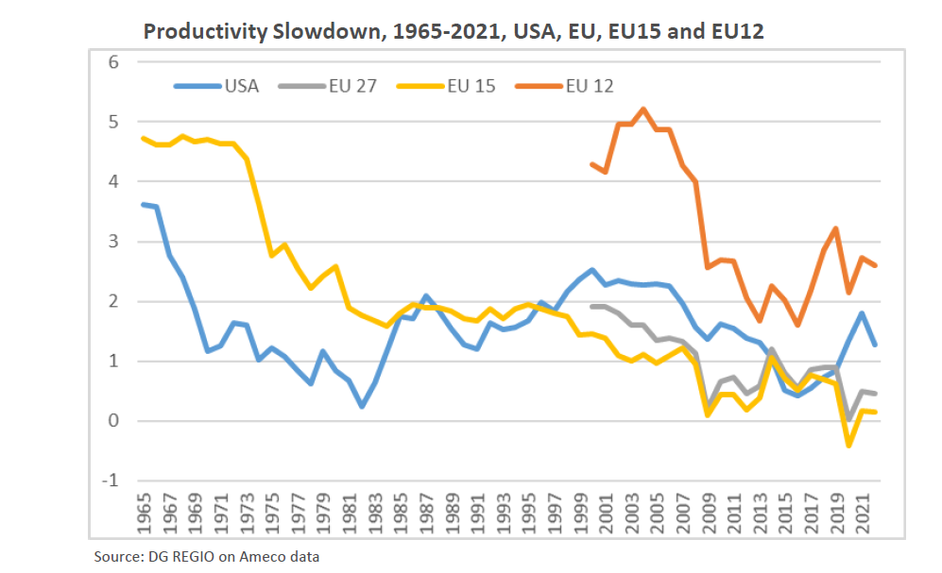
WORLD PRODUCTIVITY
COMPARISON

Slide 18
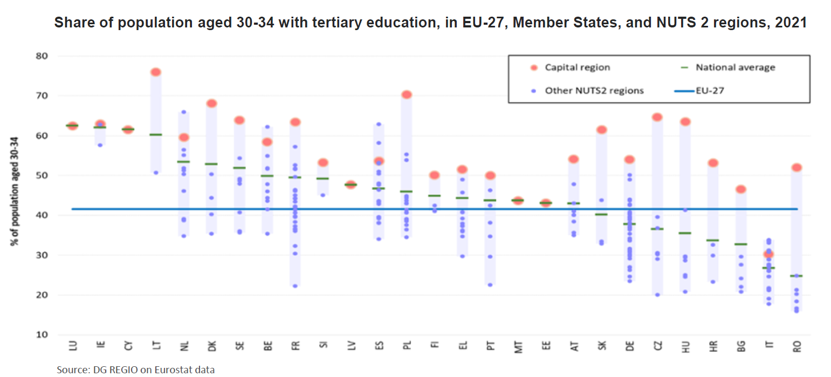
EDUCATION

Slide 19
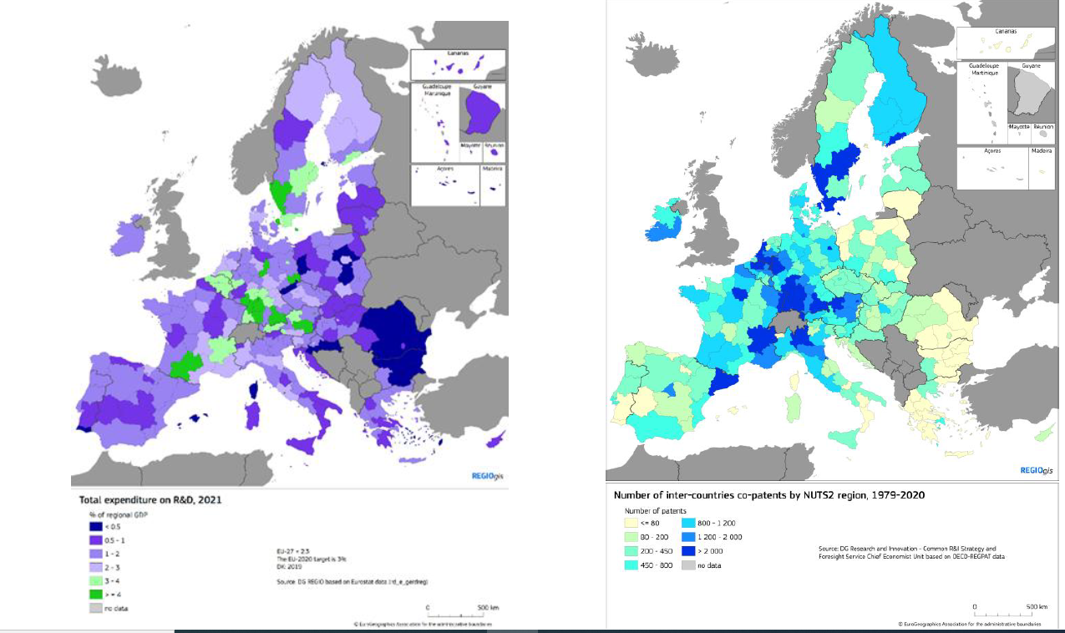
R&D (left)
and
INTER-COUNTRIES CO-PATTENTING (right)

Slide 20
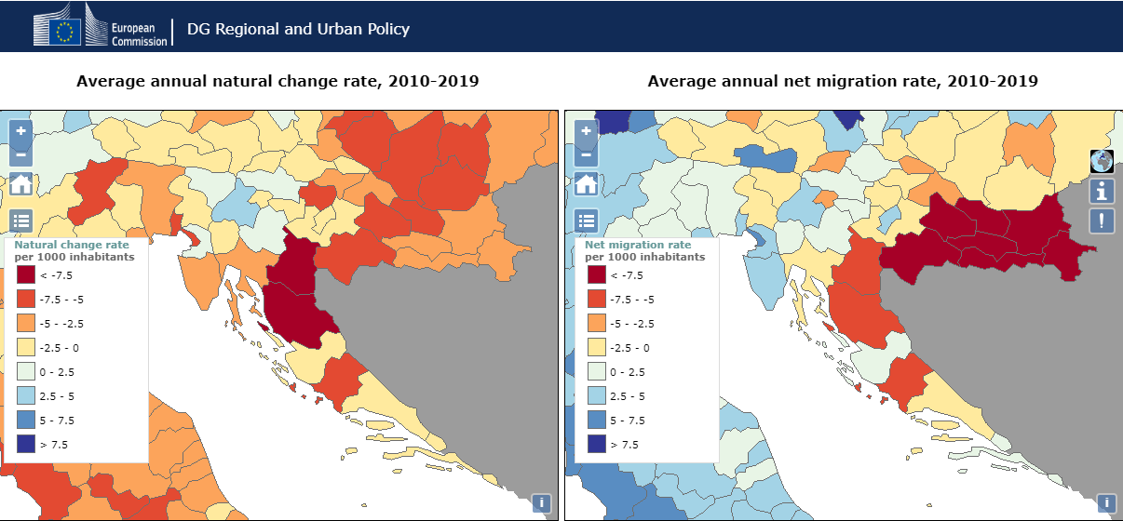
DEMOGRAPHY

Slide 21
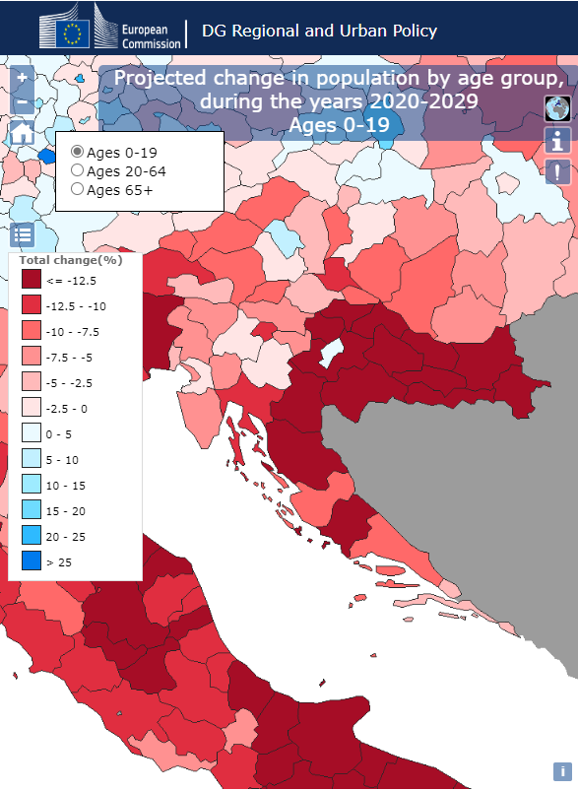
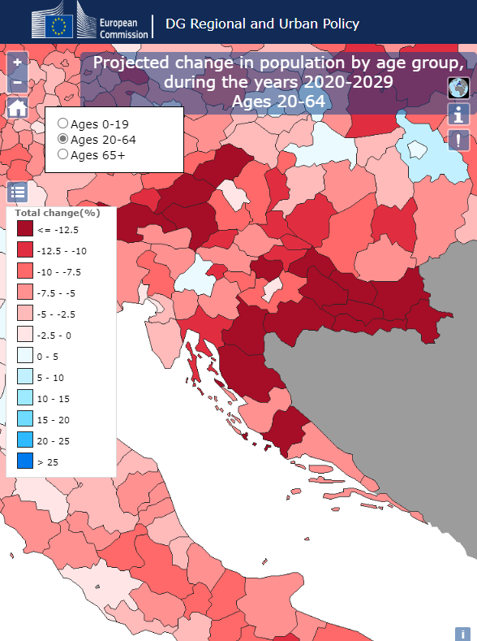
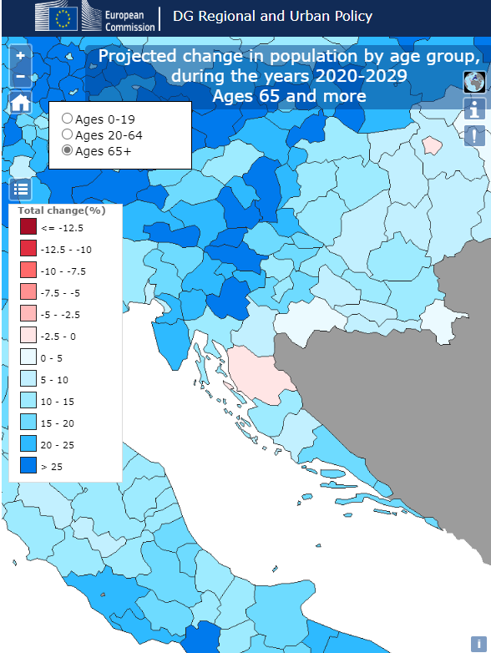
DEMOGRAPHY

Slide 22
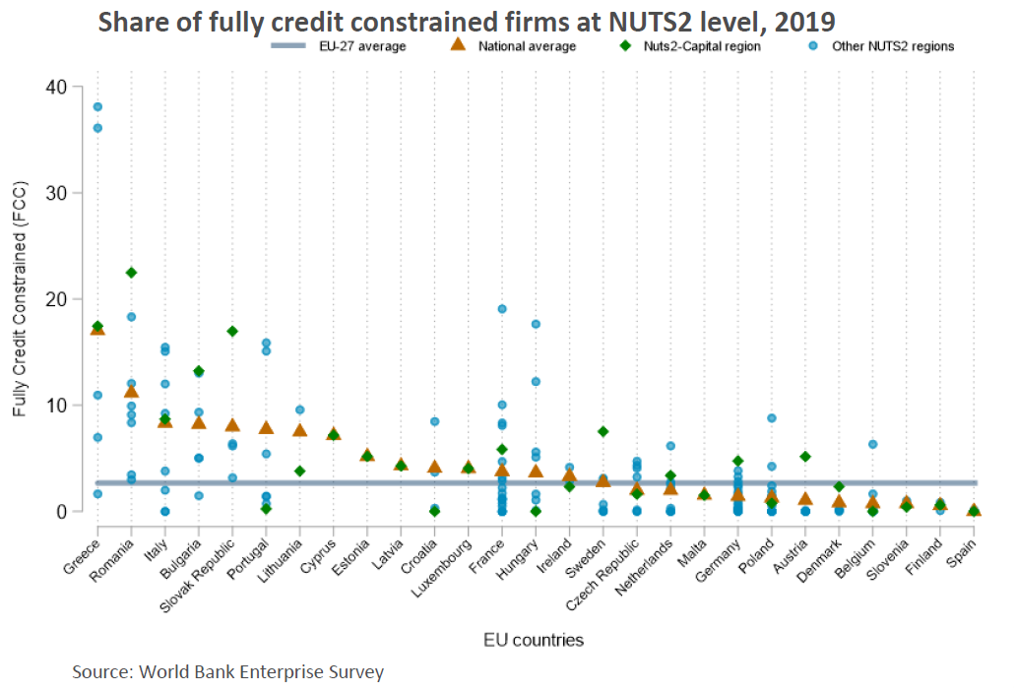
ACCESS TO FINANCE

Slide 23
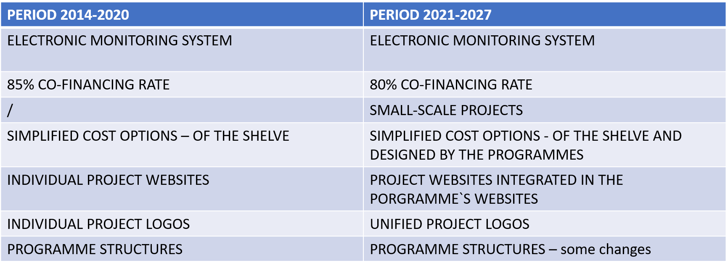
LOOKING BACK: COMPARISON OF THE
PERIOD 2014-2020 AND PERIOD 2021-2027

Slide 24
LOOKING BACK: PREVIOUS PERIODS
Open Call System
Co-financing „ready-to-go“ projects
New terms such as CAPITALISATION + SYNERGIES
Enforcing anti-fraud policy (use of Arachne)
From specific programme indicators to common indicators
Pre-defined strategic projects in the field of flood-reduction measures in period 2014-2020
Small-scale projects

Slide 25
LET‘S MENTI
www.menti.com use code: 6251 6884

Slide 26

QUESTIONS TO BE ADDRESSED
REGARDING FUTURE
  Do we know how to cooperate within country or internationally?
  Do we have the CAPACITY, know how and political willingness?
  Do we share common vision and goals for the Cohesion Policy?
  How to place cohesion higher on the EU agenda?
  Do we want to include the cohesion objective in all EU policies or have it as its own?
  How to combine the goals of cohesion and competitiveness?
  To what extent should cohesion policy be linked to reforms and/or investments?
  Should future cohesion policy be more performance-based?
  What elements of the RRF mechanism are worth including in future cohesion policy to increase its effectiveness and result-orientation?
  Should there be an overall territorial framework at the EU level, which would identify territorial objectives, that have to be addressed?

Slide 27
THANK YOU FOR YOUR ATTENTION!

